Slide 1
DATA AND COMPUTER COMMUNICATION

Slide 2
Module-1 (Data Transmission Basics)

Slide 3
Communication model - Simplex, Half duplex, Full duplex transmission. Periodic analog signals - Sine wave, Amplitude, Phase, Wavelength, Time and frequency domain, Bandwidth. Analog & digital data and signals. Transmission impairments - Attenuation, Delay distortion, Noise. Data rate limits - Noiseless channel, Nyquist bandwidth, Noisy channel, Shannon's capacity formula.

Slide 4
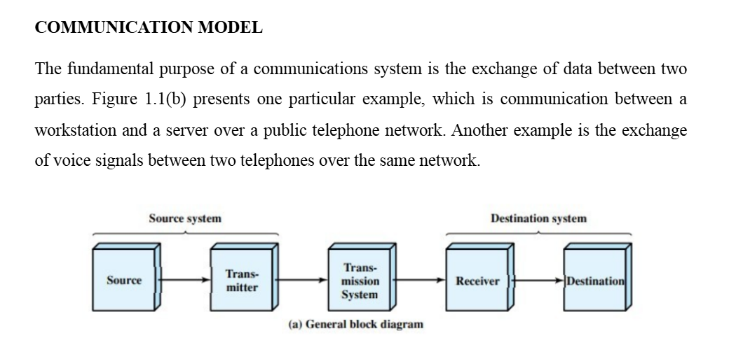

Slide 5
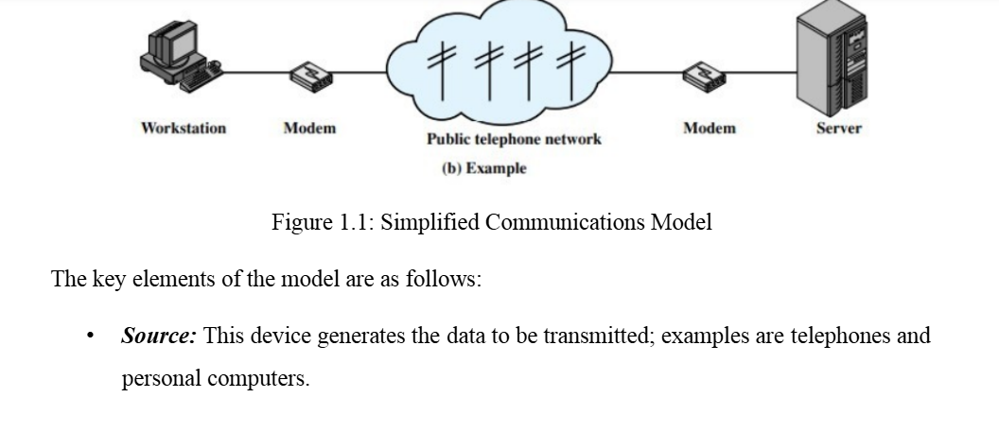

Slide 6
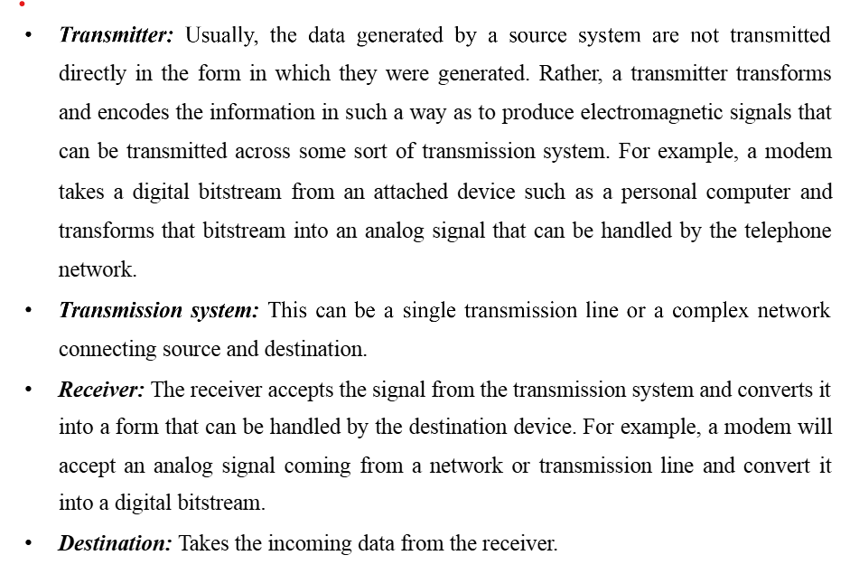

Slide 7
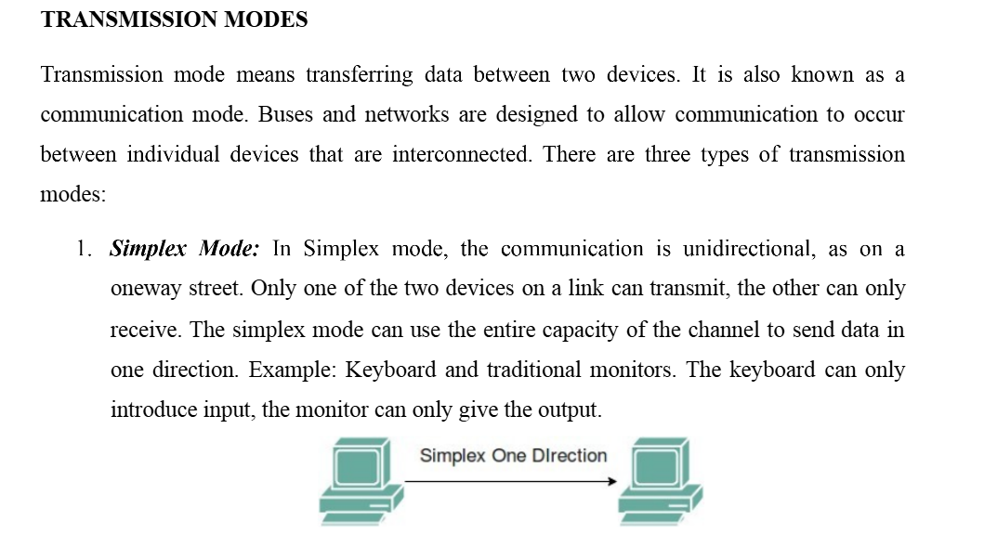

Slide 8
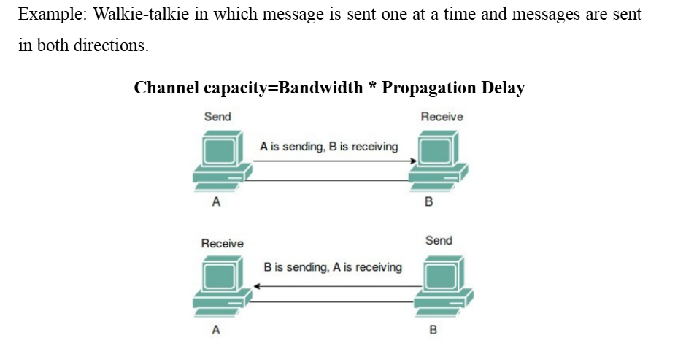
2. Half-Duplex Mode: In half-duplex mode, each station can both transmit and receive, but not at the same time. When one device is sending, the other can only receive, and vice versa. The half-duplex mode is used in cases where there is no need for communication in both directions at the same time. The entire capacity of the channel can be utilized for each direction.

Slide 9
3. Full-Duplex Mode: In full-duplex mode, both stations can transmit and receive simultaneously. In full-duplex mode, signals going in one direction share the capacity of the link with signals going in another direction, this sharing can occur in two ways:
•Either the link must contain two physically separate transmission paths, one for sending and the other for receiving. Or
•The capacity is divided between signals traveling in both directions.
Full-duplex mode is used when communication in both directions is required all the time. The capacity of the channel, however, must be divided between the two directions. Example: Telephone Network in which there is communication between two persons by a telephone line, through which both can talk and listen at the same time. Channel Capacity = 2* Bandwidth*propagation Delay

Slide 10
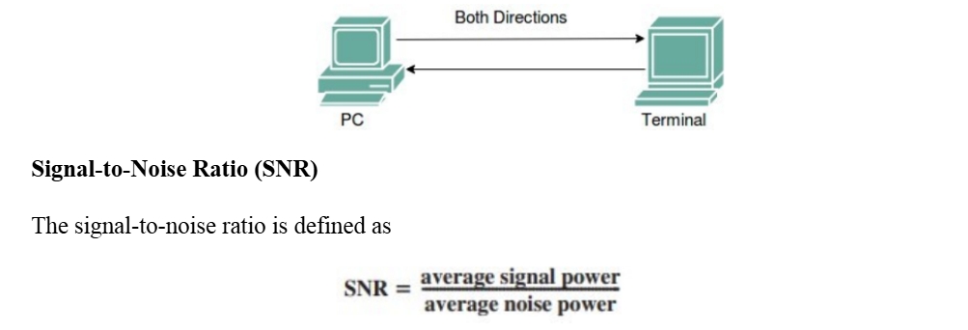
We need to consider the average signal power and the average noise power because these may change with time. SNR is actually the ratio of what is wanted (signal) to what is not wanted (noise). A high SNR means the signal is less corrupted by noise; a low SNR means the signal is more corrupted by noise.

Slide 11
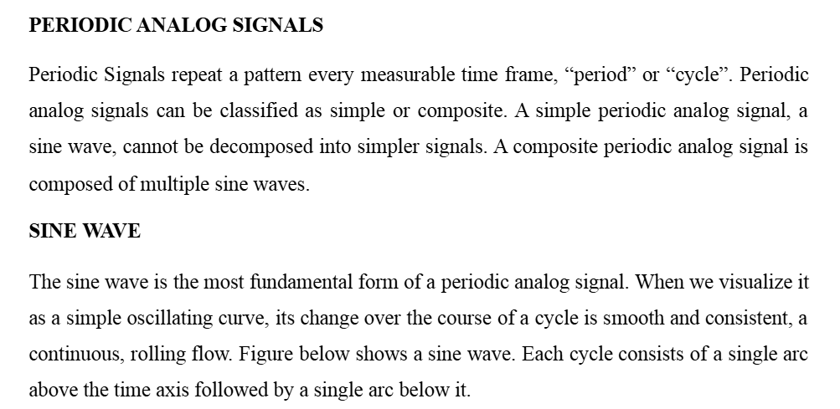

Slide 12
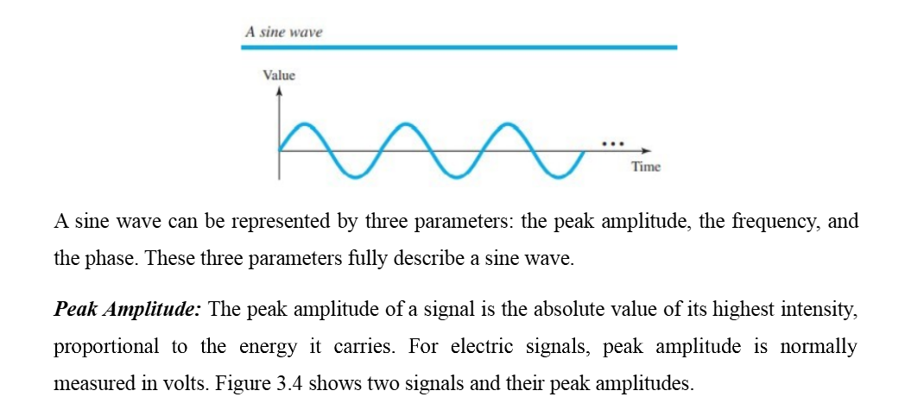

Slide 13
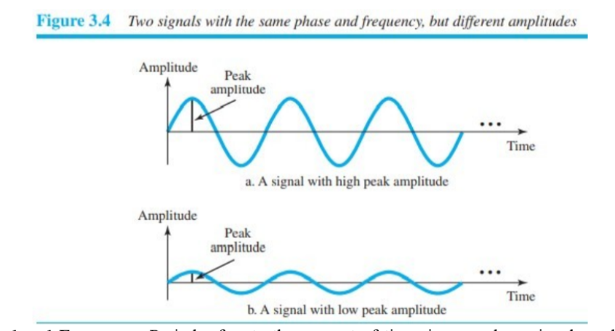

Slide 14
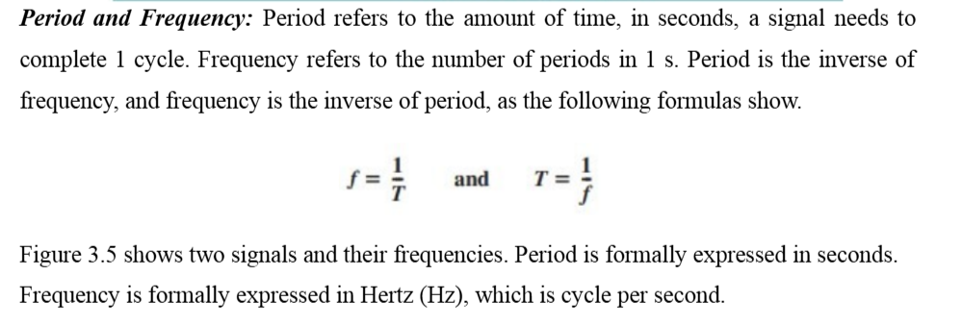

Slide 15
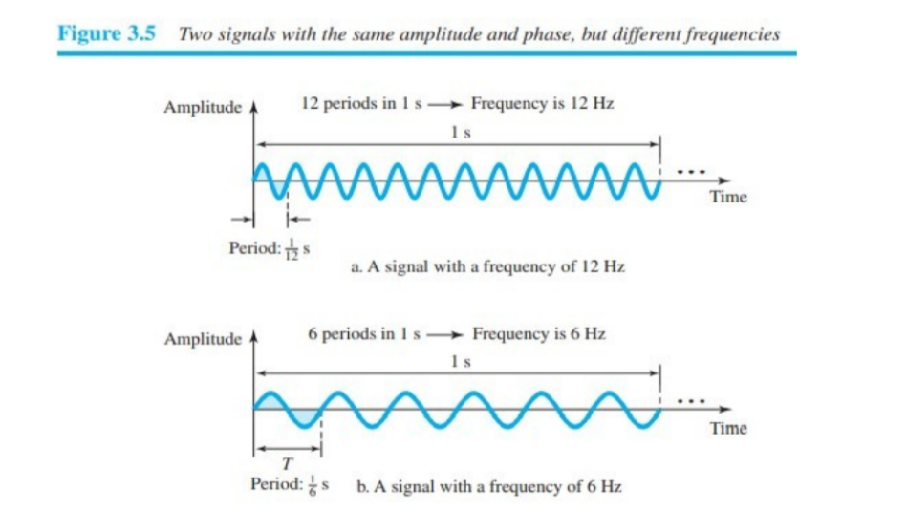

Slide 16
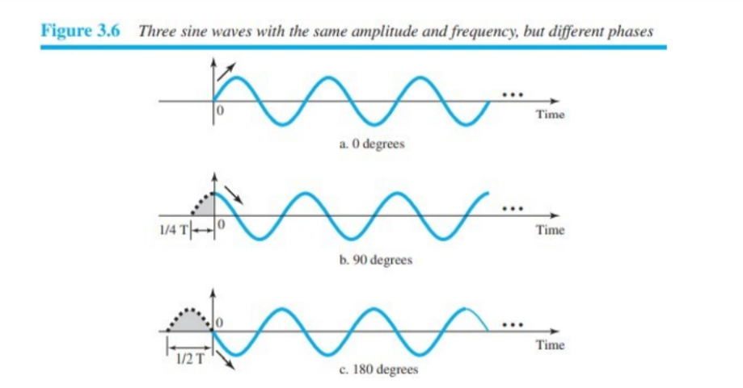
Phase: The term phase, or phase shift, describes the position of the waveform relative to time 0. If we think of the wave as something that can be shifted backward or forward along the time axis, phase describes the amount of that shift. It indicates the status of the first cycle.
Phase describes the position of the waveform relative to time 0. Phase is measured in degrees or radians [360º is 2π rad; 1º is 2π/360 rad, and 1 rad is360/(2π)]. A phase shift of 360º corresponds to a shift of a complete period; a phase shift of 180° corresponds to a shift of one-half of a period, and a phase shift of 90º corresponds to a shift of one-quarter of a period (see Figure 3.6).

Slide 17
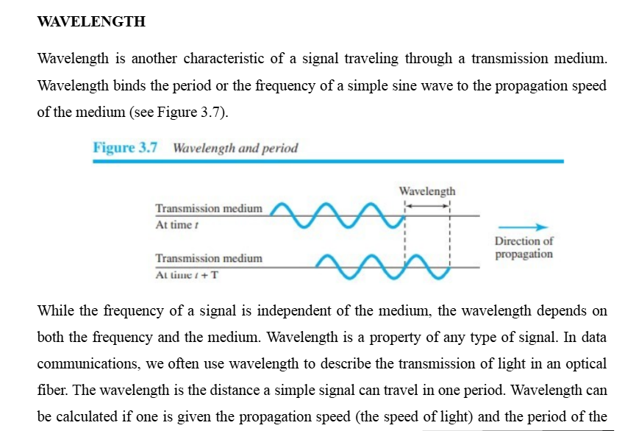
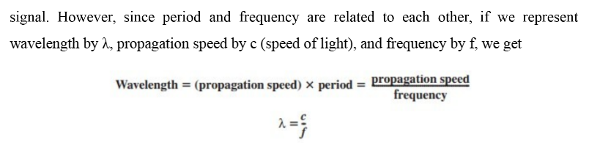

Slide 18
TIME AND FREQUENCY DOMAIN
A sine wave is comprehensively defined by its amplitude, frequency, and phase. We have been showing a sine wave by using what is called a time-domain plot. The time-domain plot shows changes in signal amplitude with respect to time (it is an amplitude-versus-time plot). Phase is not explicitly shown on a time-domain plot.
To show the relationship between amplitude and frequency, we can use what is called a frequency-domain plot. A frequency-domain plot is concerned with only the peak value and the frequency. Changes of amplitude during one period are not shown. Figure 3.8 shows a signal in both the time and frequency domains.

Slide 19
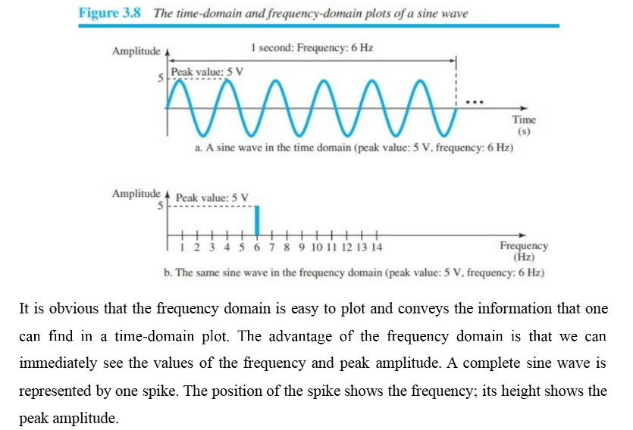

Slide 20
BANDWIDTH
The range of frequencies contained in a composite signal is its bandwidth. The bandwidth is normally a difference between two numbers. For example, if a composite signal contains frequencies between 1000 and 5000, its bandwidth is 5000 − 1000, or 4000.
The bandwidth of a composite signal is the difference between the highest and the lowest frequencies contained in that signal. Figure 3.13 shows the concept of bandwidth. The figure depicts two composite signals, one periodic and the other nonperiodic. The bandwidth of the periodic signal contains all integer frequencies between 1000 and 5000 (1000, 1001, 1002, . . .). The bandwidth of the nonperiodic signals has the same range, but the frequencies are continuous.

Slide 21
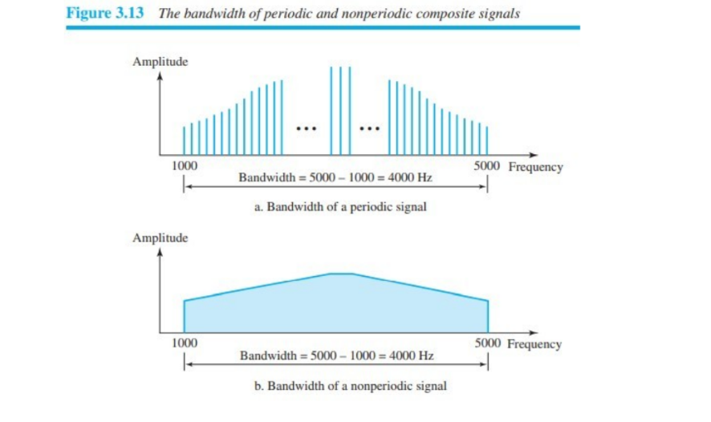

Slide 22
ANALOG AND DIGITAL DATA
Data can be analog or digital. The term analog data refers to information that is continuous; digital data refers to information that has discrete states.
For example, an analog clock that has hour, minute, and second hands gives information in a continuous form; the movements of the hands are continuous.
On the other hand, a digital clock that reports the hours and the minutes will change suddenly from 8:05 to 8:06.
Analog data, such as the sounds made by a human voice, take on continuous values. When someone speaks, an analog wave is created in the air. This can be captured by a microphone and converted to an analog signal or sampled and converted to a digital signal.
Digital data take on discrete values. For example, data are stored in computer memory in the form of 0s and 1s. They can be converted to a digital signal or modulated into an analog signal for transmission across a medium

Slide 23
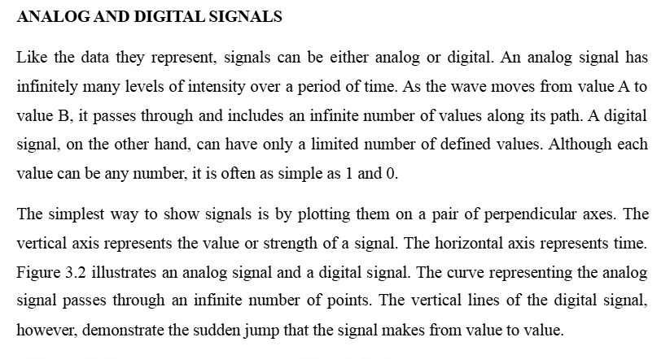
ANALOG AND DIGITAL SIGNALS

Slide 24
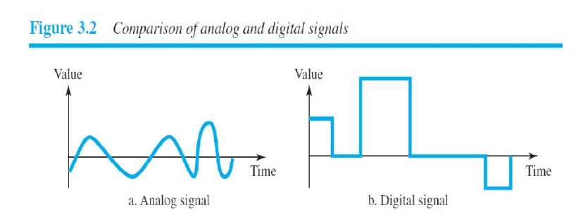

Slide 25
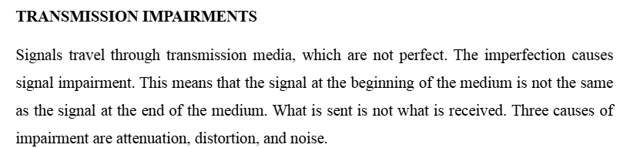

Slide 26
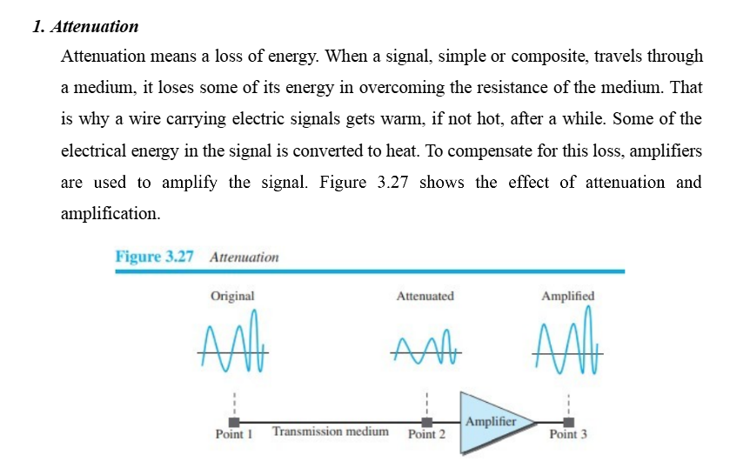

Slide 27
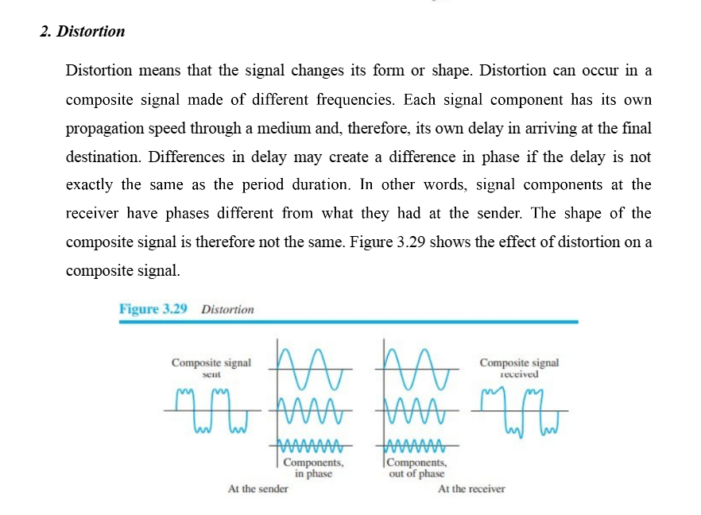

Slide 28
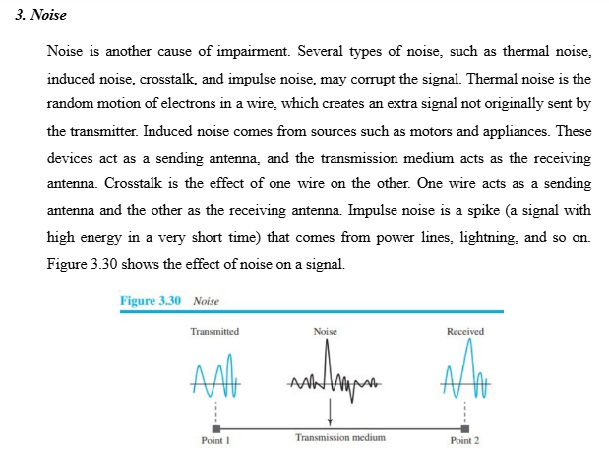

Slide 29
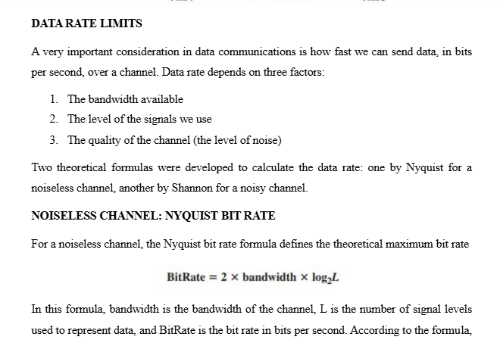

Slide 30
